Slide 1
about:Future projects
Conference/event name
Location
name
openSUSE Ambassador
name@opensuse.org

Slide 2
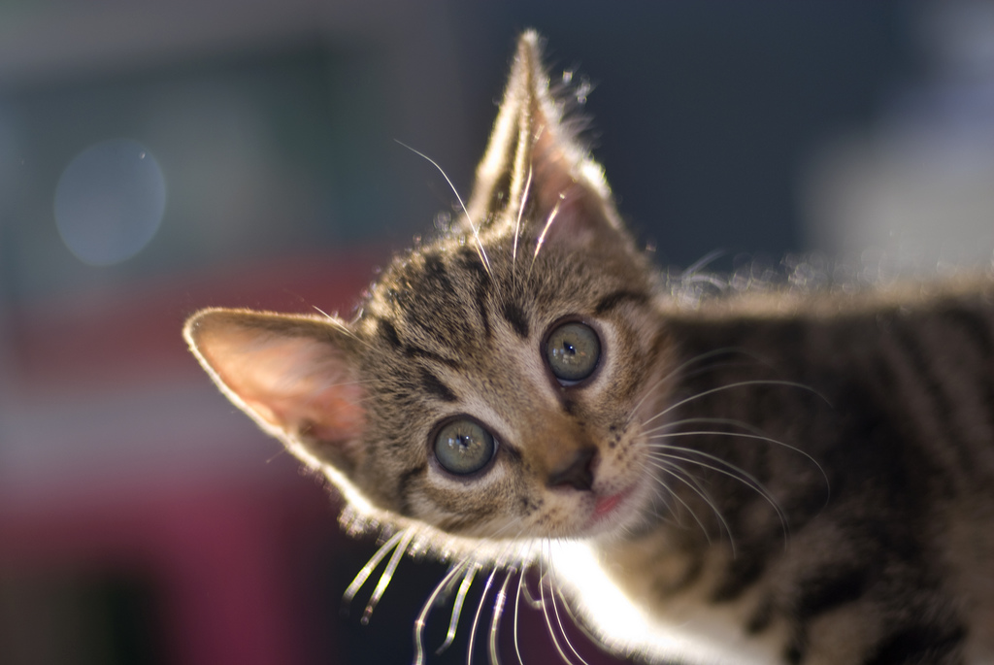
Me
Notes:
about yourself!

Slide 3
SUSE Studio
Bretzn & Appstream
Tumbleweed
Notes:
We will talk about 3 different openSUSE (based) projects besides the openSUSE distribution and the Open Build Service:
SUSE Studio (Novell product)
Project Bretzn (openSUSE/KDE)
Appstream (openSUSE/cross distro)

Slide 4
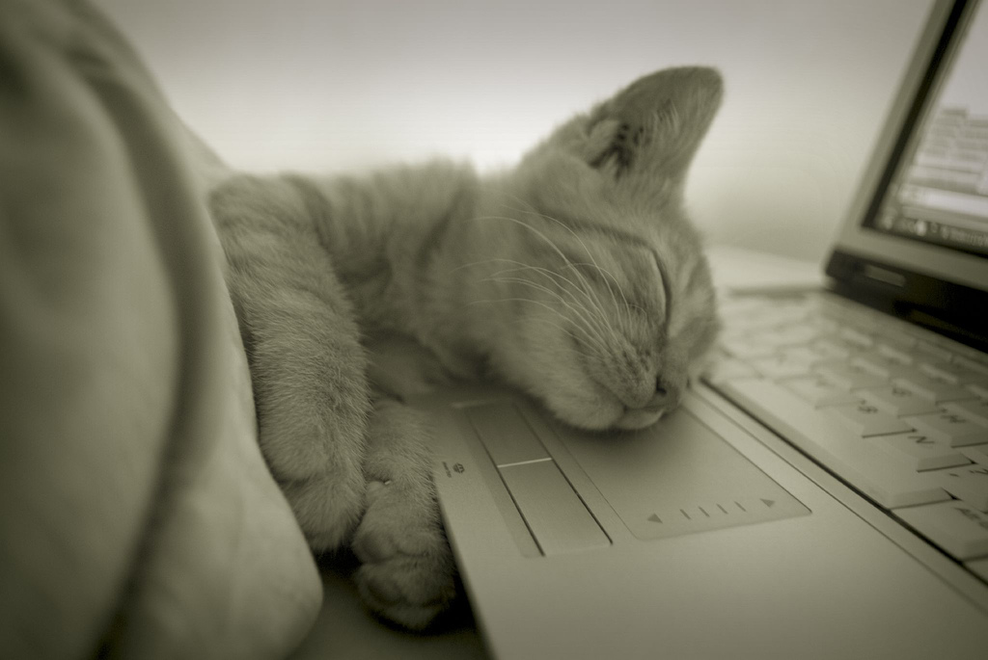
Sleepy?
Notes:
For the lazy among us: how to click together a completely customized linux distribution in 5 minutes!

Slide 5
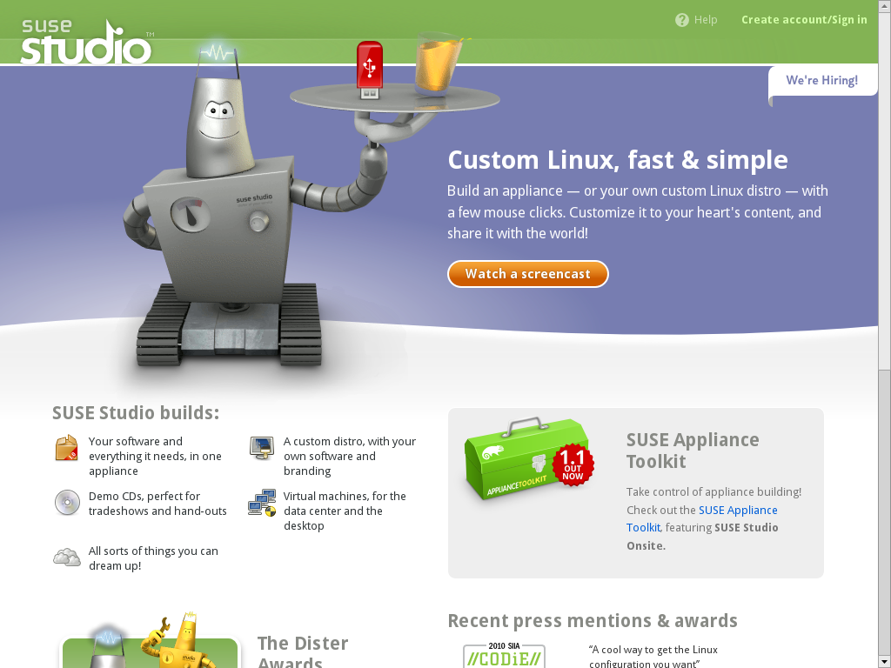
Notes:
The tool: SUSE Studio. Free to use on SUSEStudio.com!
Go there, log in via openID, Google or create an account.
It works simple: you choose to create a new appliance and give it a name.

Slide 6
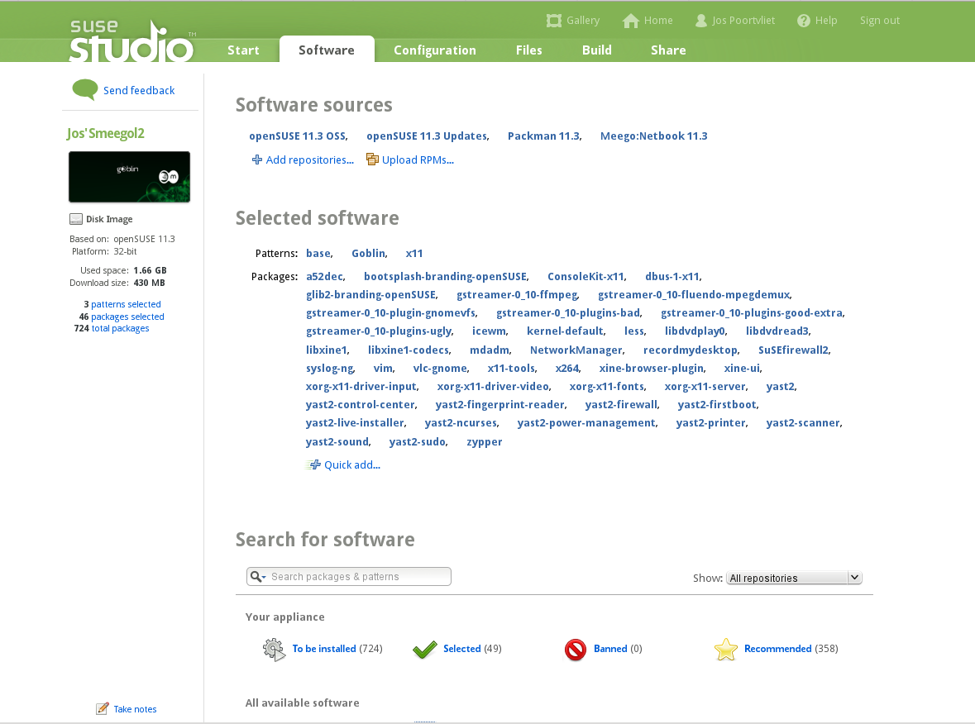
Notes:
pick a base template (SLE or openSUSE based): minimal OS, only X, minimal GNOME, full KDE, File/Print server etc.
Choose your own custom package selection from the 30.000 repositories on build.opensuse.org (or upload your own packages)

Slide 7

Notes:
choose your own custom artwork, configuration, scripts or upload overlay files. Anything can be changed!
Studio takes care of almost everything: if you configure MySQL but forget to add it, it will warn and help you.

Slide 8

Notes:
Configure your VM, hard drive, USB or CD/DVD output. You can also upload your newly build operating system directly to the Amazon EC2 Cloud!
You can include WebYast to control your new appliance remotely from the browser!

Slide 9

Notes:
Studio builds your OS like you want it.
BTW you can export and import KIWI config scripts. KIWI is the underlying tech of Studio, it is FOSS and developed in openSUSE. Gives even more control!

Slide 10
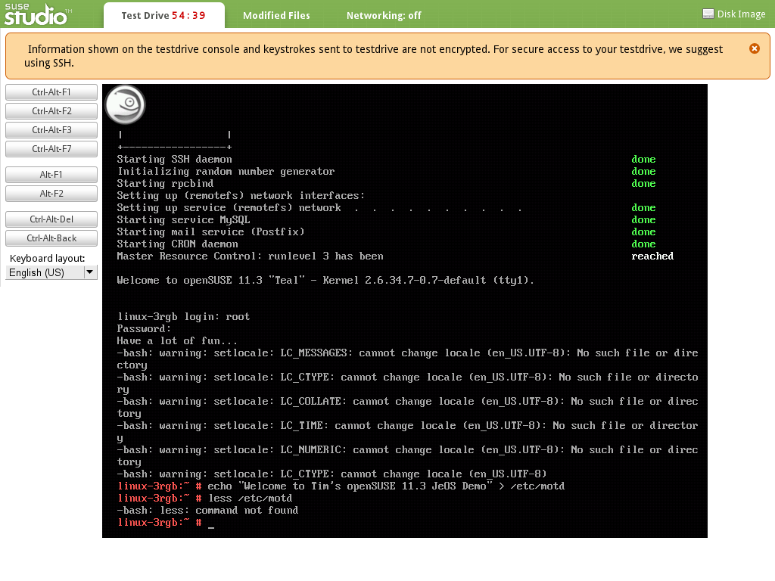
SUSEStudio.com
http://distributions.freedesktop.org/wiki/AppStream
Notes:
Once you are done you can test drive your appliance for 45 minutes through a flash plugin or via remote SSH. Any changes you make are saved in the appliance!
That's it, go and try it on susestudio.com!

Slide 11

opensuse.org/Tumbleweed
Notes:
Tumbleweed by Greg Kroah-Hartman
Rolling release openSUSE
Like Arch and Gentoo, but on top of a unsable distro which still allows you a predictable and stable release schedule!
Step off the upgrade tred mill, be always up to date!
build upon OBS, very hard without (that's why WE do it, not others)
Go to opensuse.org/Tumbleweed for fun!

Slide 12
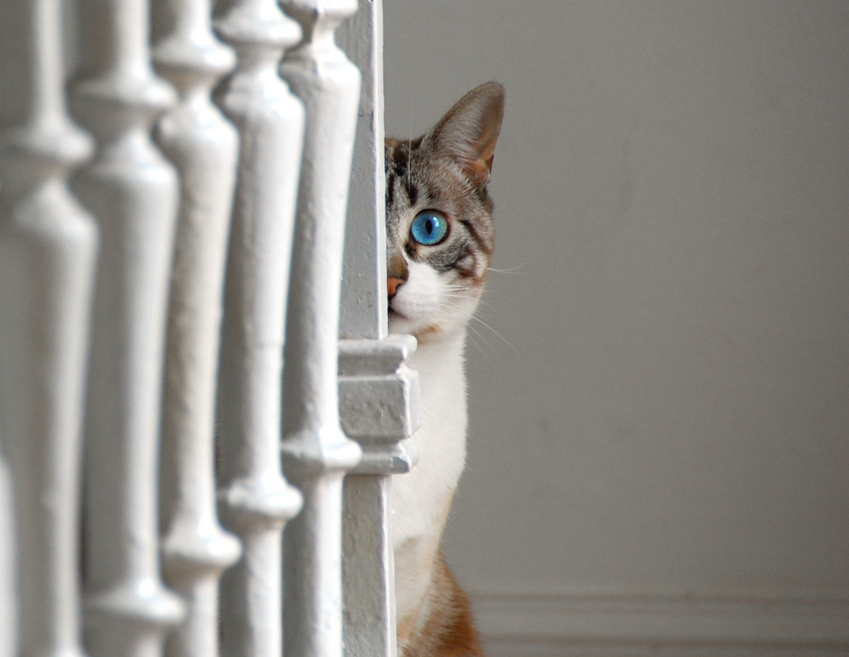
Upcoming
Notes:
move to future
latest & hottest projects

Slide 13
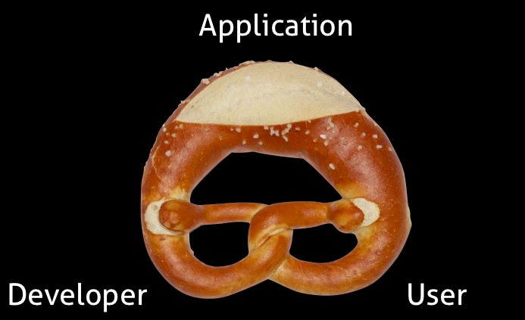
Notes:
Supercool: Project Bretzn (german pretzl)
Problem: you need more than code an app. Build, distribute, gather feedback, answer questions... OBS solves building, there are app stores and sites like gtk-apps.org and kde-apps.org to distribute applications, bug trackers for feedback. All manual and boring!

Slide 14
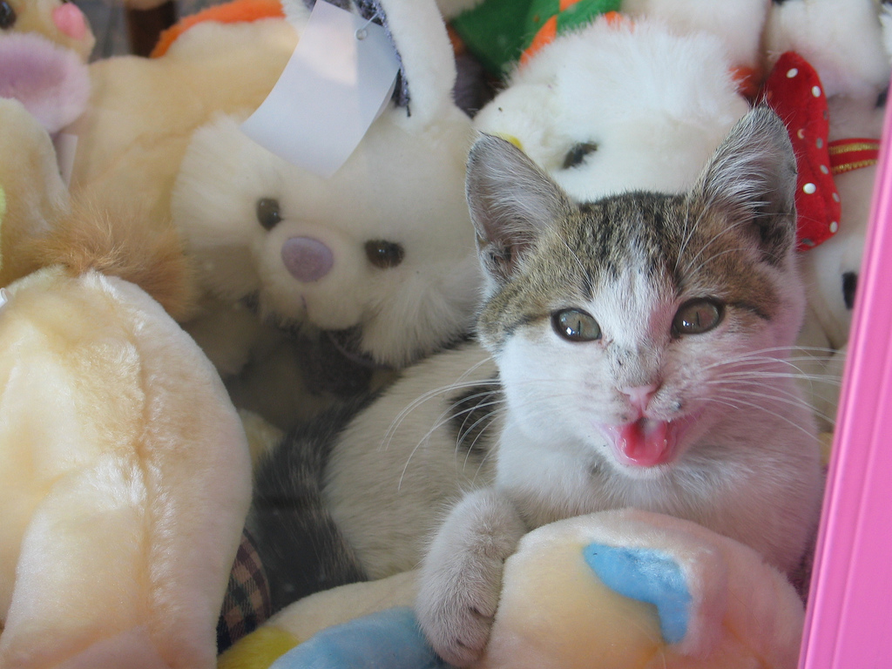
Together
Notes:
Bretzn ties it together:
OBS (incl auto-generating build files, upcoming feature)
Open Collaboration Services (freedesktop.org API) for publishing
Appstores etc; social desktop, twitter, facebook etc
OCS again for feedback collection

Slide 15
Notes:
Screenshot s howing some current app stores.
MeeGo, OVI, AppUp (intel), OpenDesktop (kde-apps, GTK-apps etc), Qt and GTK clients

Slide 16
Collaboration: Appstream
Debian
Ubuntu
Fedora
openSUSE
Mandriva
Notes:
Related to Bretzn is Appstream. You saw Bretzn also works on application installers. But you would need one on every distribution, yes? Enter Appstream, a project started by Vincent Untz from openSUSE at the openSUSE conference in 2010.

Slide 17
interface
comments
screenshots
UI
ratings
Notes:
The appstream project aims to build a application installer infrastructure. Not sharing package management or things like that, but the user-visible side is the focus.
We need a easy UI with screenshots, ratings, comments

Slide 18
re-use
standards
customizable
open
together
socialdesktop.org/bretzn/
distributions.freedesktop.org/wiki/AppStream
Notes:
And we build that shared:
Screenshots from debian, UI from Ubuntu app installer, Freedesktop.org OCS (used by Bretzn!) for comments and ratings.
End result: better for everyone!

Slide 19

SuperKitty!
Notes:
By now everyone has to be convinced. openSUSE = super Kitty!
Awesome technology
Great plans

Slide 20

Newcomers welcome
Notes:
Which is always looking for new volunteers
people who actually want to make a difference!

Slide 21

opensuse.org
planet.opensuse.org
opensuse.org/Portal:How_to_participate
opensuse.org/Junior_jobs
features.opensuse.org
build.opensuse.org
openhatch.org
#opensuse-project

Slide 22

Join the gang
Notes:
... come join us and have fun...
Try openSUSE, Tumbleweed, SUSE Studio, TRY OBS, play with us!

Slide 23

Be a Geeko/Kitten
Notes:
Be the Geeko you can be!

Slide 24
Kitty Image credits
Me: Merlijn Hoek
You: artolog
openSUSE: clevergrrl
Novell: sensual shadows
Business: marissa cap
Strategy: dabogirl
Others: pasotraspaso
We are nice: cseeman
Beware: ian
SuperKitty: malingering
Cuddly: andreas solberg
Newcomers: abcrumly
Join the gang: malingering
GeekoKitten: no idea
To be found on Flickr under the above names with a Creative Commons license. Thanks all!

Slide 25
Your next Linux Distribution!

